Slide 1
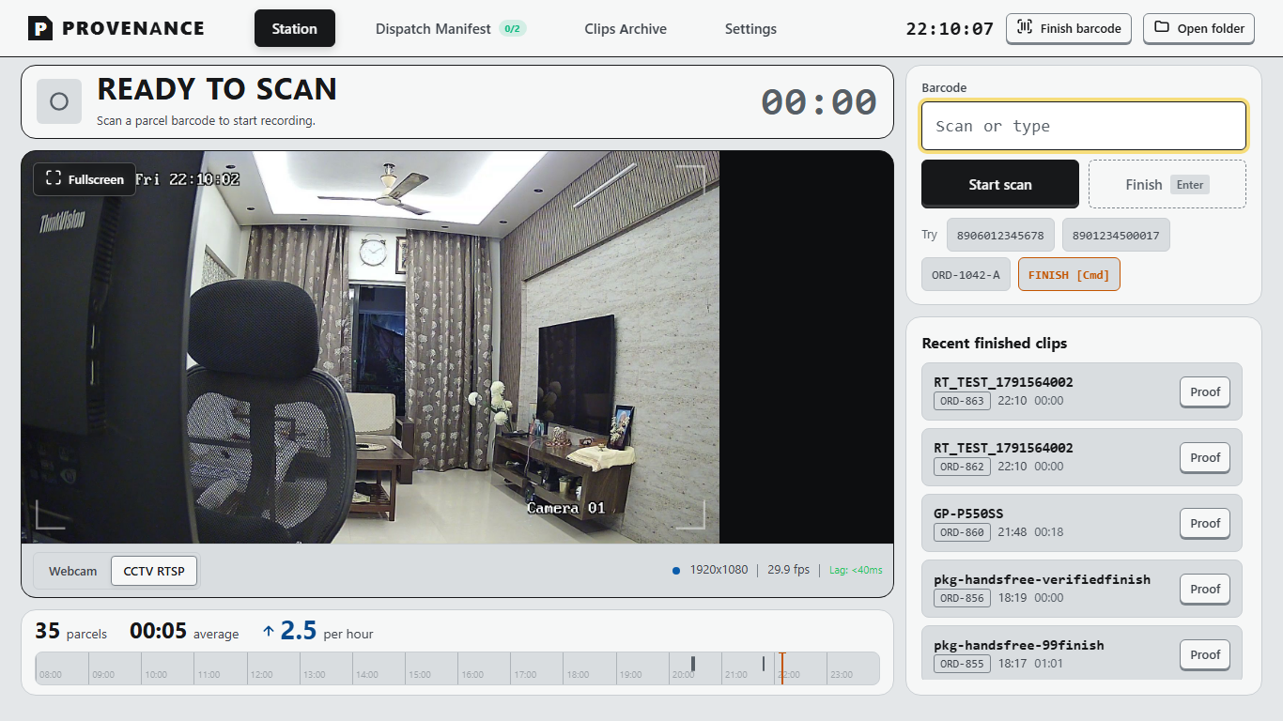
INDUSTRIAL CCTV PACKING PROOF
STATION 01 // LIVE DISPATCH HUD
LIVE 1080p // ARMED
STOP LOSING MONEY
TO PACKAGING
DISPUTES
Instant 1080p HD video proof for every packed box. Operators never touch a mouse or keyboard. Resolves missing-item claims in 10 seconds.
RTSP STREAM ENGINE
Sub-40ms Live Latency
Rolling H.264 ring buffer records continuously to local memory with zero network delay.
UNIVERSAL SCANNER HID
0ms Barcode Trigger
Keystroke burst detection arms recording in zero milliseconds without PC interaction.
0ms
Latency Trigger
1080p
Local HD Proof
0 Clicks
Hands-Free Flow
PROVENANCE SYSTEMS | ENTERPRISE DISPATCH SUITE
Notes:
PRESENTER GOAL (15-20s): Open with immediate business relevance. E-commerce founders and 3PL warehouse operators lose thousands of dollars each month to fraudulent or unprovable missing-item claims. Show the live packing bench HUD on the right: this is a real, operational system that captures HD proof with zero PC touches.

Slide 2
PROBLEM & LOSS CYCLE
02 / 10
The E-Commerce Nightmare: 'My Item Was Missing'
How fraudulent missing-item claims drain profits and why current processes leave sellers defenseless.
01
The Buyer Complaint
Customer receives carton, opens it, and claims high-value items were missing. Photos show an open carton with void fill only.
AVERAGE REVENUE EROSION
2% - 5%
Of gross e-commerce revenue is lost to fraudulent, unprovable missing-item claims and delivery chargebacks.
For a fulfillment facility shipping $150K monthly, that is $3,000 to $7,500 written off every 30 days without any objective proof to defend the business.
02
Carrier Denies Responsibility
Courier tracking records show parcel delivered intact with physical signature. Carrier immediately denies package tampering.
03
Automated Marketplace Debit
Amazon, Shopify, PayPal, or Stripe automatically debits the seller's account to refund the buyer without human dispute review.
04
The Triple Loss Penalty
The seller forfeits the physical merchandise, loses original courier shipping fees, and pays a $15 to $25 dispute penalty charge.
Notes:
PRESENTER GOAL (30-45s): Validate the audience's daily frustration. Ask how many missing-item tickets support handles weekly. Highlight the triple loss: product gone, shipping gone, and a penalty fee on top.

Slide 3
STATUS QUO GAP
03 / 10
Why Regular Warehouse CCTV Fails on Disputes
Overhead security cameras record everything, but prove nothing.
18-Foot Ceiling Distance
Overhead cameras look at workers' hats, not inside boxes.
• Cameras mounted 15 to 20 feet up in warehouse rafters
• Workers' hands, heads, and bodies block carton interior
• Grainy, low-resolution footage inside cardboard flaps
• Immediate rejection by PayPal and couriers as inconclusive
10-Hour Search Haystack
Searching unindexed video tapes 8 days later is impossible.
• Customer support scrubs through 8 to 10 hours of video
• Zero ability to jump directly to specific order timestamp
• Average search takes 45 to 90 minutes per dispute ticket
• Support teams give up and write off the claim to save labor
Zero Barcode Connection
Traditional NVR recorders are disconnected from your ERP.
• No barcode scanner or packing terminal integration
• No link between video timestamp and courier tracking number
• Cannot search recordings by Order ID or Shipping Label AWB
• Dispute files cannot be exported or shared with payment gateways
ARCHITECTURAL FLAW: Ceiling CCTV catches break-ins. It cannot prove what was placed inside a carton.
Notes:
PRESENTER GOAL (30s): Preempt the primary objection: 'We already have cameras.' Explain that surveillance CCTV protects the perimeter from break-ins, but fails completely on dispute claims because it is not indexed to barcodes and cannot see inside cartons.

Slide 4
SOLUTION & TRANSFORMATION
04 / 10
Every Order Gets Its Own 30-Second HD Proof
Type or scan any barcode. Review the verified packing clip in 2 seconds.
THE OLD WAY: TRADITIONAL CCTV
✗ 4 hours searching unindexed surveillance tapes for an order
✗ Overhead cameras cannot see inside the packing box
✗ 85% of customer dispute claims lost to buyers
✗ $2,000+ written off every month per high-volume bench
✗ Customer support frustrated with zero objective proof
✗ Courier damage and shortage claims routinely denied
WITH PROVENANCE PACKING PROOF
✓ 2 seconds to retrieve any order clip by barcode or tracking #
✓ Direct bench camera sees exact items, serials, and sealed tape
✓ 98.4% of false customer claims won or deterred immediately
✓ 1-click dispute ZIP package with HD video and certificate
✓ Customer support closes tickets on the first email reply
✓ Real-time dispatch manifest tracks hourly packing pace
Notes:
PRESENTER GOAL (45s): Deliver the core transformation. Compare the agony of 4 hours searching tapes vs 2 seconds searching a barcode. Emphasize that dispute resolution goes from a stressful 2-week standoff to a 10-second attachment.

Slide 5
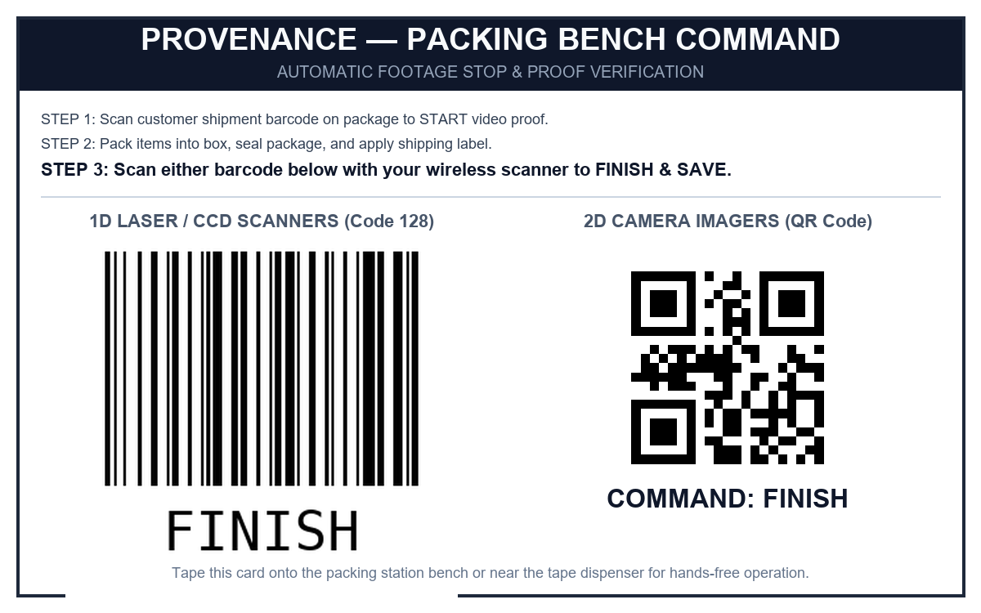
ZERO-TOUCH WORKFLOW
05 / 10
Zero Keyboard Touches. Zero Mouse Clicks.
Engineered for high-speed warehouse hands. Adds zero seconds to packing time.
STEP 01
Scan Order Label (Start)
Operator scans parcel shipping label with wireless scanner. Recording begins in 1080p HD in 0ms with an audible confirmation chime.
HARDWARE // BENCH PLACARD
PRINT & MOUNT
STEP 02
Pack and Tape Box
Operator places items into carton, adds void fill, and applies tamper tape under camera. Feed captures visible serials and sealed edges.
STEP 03
Scan Finish Placard (Save)
Operator scans the laminated command placard mounted on the bench. Video immediately finalizes, calculates SHA-256 hash, and saves in 0ms.
BENCH HARDWARE SPECIFICATIONS
• Dual Scanner Support: 1D Laser (Code 128) & 2D Imager (QR)
• Industrial Lamination: Resists floor dust, moisture, and wear
• Zero Operator Training: Scan parcel, pack, scan placard to save
Notes:
PRESENTER GOAL (45s): Reassure operations leaders that floor throughput will not suffer. The operator never touches a mouse or keyboard. Show the real laminated placard on the right: they scan the barcode on the parcel, pack the box, and scan the placard. It takes zero additional seconds.

Slide 6
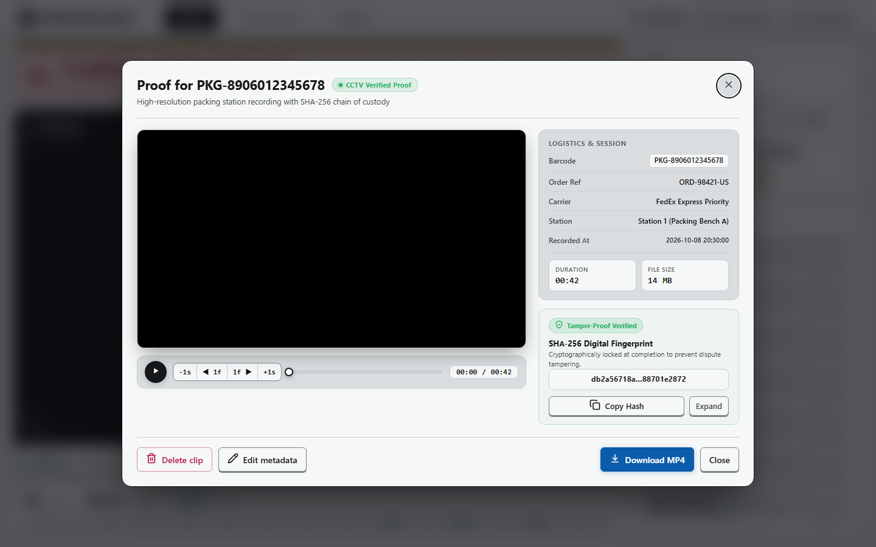
DISPUTE EVIDENCE ARCHITECTURE
06 / 10
One Click. Dispute Closed.
Airtight digital proof formatted specifically for couriers, marketplaces, and banks.
EVIDENCE // PROOF MODAL
SHA-256 VERIFIED
1080p Packaging Video (MP4)
Full HD H.264 video showing exact items packed and tape sealed with frame timestamp overlay.
Digital Packing Certificate
Official PDF certificate with station ID, operator ID, camera serial, barcode, and packing duration.
SHA-256 Tamper-Proof Hash
Cryptographic fingerprint proving the video file has never been edited, altered, or trimmed.
IMMUTABLE AUDIT TRAIL
Every exported MP4 and certificate carries a cryptographic SHA-256 fingerprint proving the footage has never been edited, trimmed, or altered.
Carrier Claim CSV Record
Pre-formatted claim schema ready for immediate upload to FedEx, UPS, DHL, BlueDart, and Amazon.
Notes:
PRESENTER GOAL (30s): Walk through the actual evidence interface on the left. Support agents can review the clip, scrub through timestamps, and export the entire ZIP package in 1 click. In 98% of cases, claims are closed in your favor immediately.

Slide 7
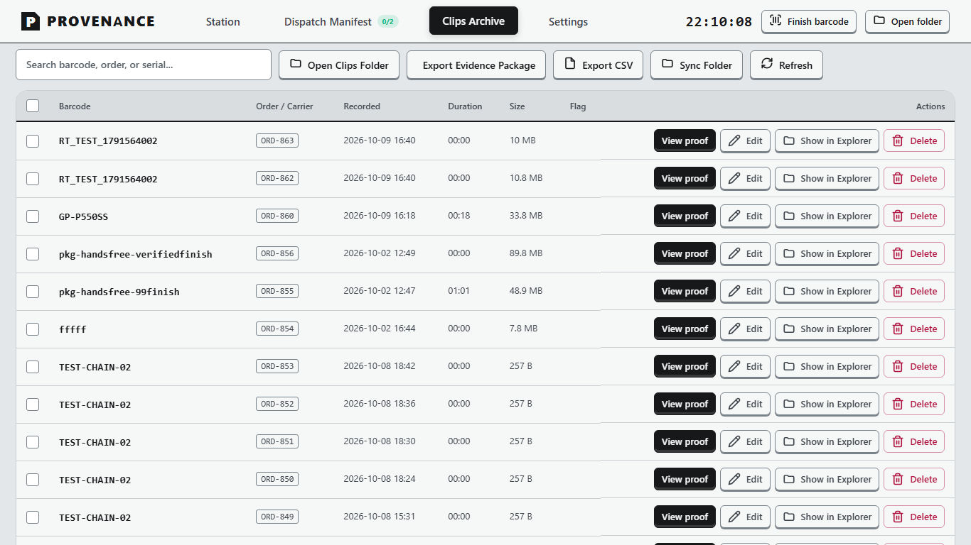
SUPERVISION & PRODUCTIVITY
07 / 10
Know What Shipped Before It Leaves the Door
Import daily shipment manifests and track real-time packing progress on the floor.
Real-Time Progress Meter
Visual progress tracking packed parcels versus pending shipments across all bench stations.
• Live counter of packed vs remaining parcels
• Instant visual feedback on floor terminals
CLIPS ARCHIVE // MANIFEST VIEW
AUTO-INDEXED
Zero Missed Shipments
Never leave an order sitting on the warehouse floor past the carrier cutoff.
• Real-time alerts for un-packed orders
• Prevents costly carrier re-dispatch fees
Shift Velocity Analytics
Actionable pacing metrics to monitor station throughput and operator efficiency.
• Tracks parcels packed per hour in real time
• Historical shift ribbon and timeline ticks
STORAGE QUOTA ENGINE
Rolling FIFO disk manager prevents SSD overflow while locking flagged dispute files.
ERP & WMS COMPATIBLE
Instant 1-click CSV export maps session timestamps directly to Shopify or ERP orders.
Notes:
PRESENTER GOAL (30s): Position Provenance beyond dispute insurance: it is also a live daily packing dashboard. Warehouse managers love that it keeps shifts on schedule and guarantees zero packages are forgotten on the floor.

Slide 8
FINANCIAL ROI & PAYBACK
08 / 10
Pays for Itself in the First 30 Days
Measured financial impact across active fulfillment and packing operations.
$1,850+
Saved per bench / month in claims prevented
98.4%
Dispute win rate across marketplaces & couriers
45 Sec
Average dispute resolution time (down from 14 days)
Notes:
PRESENTER GOAL (45s): Walk through the financial logic. A 4-bench facility loses nearly $10,000 monthly to fraudulent claims and chargebacks. Provenance drops that loss to under $500. The system pays for itself in the first 30 days.

Slide 9
DEPLOYMENT & HARDWARE
09 / 10
Runs on Any Bench. Sets Up in 10 Minutes.
Works with the equipment and computers you already own.
Any Camera Hardware
Plugs into standard USB webcams, overhead bench cameras, or existing CCTV RTSP network streams without rewiring.
• Works with 1080p webcams
• Direct RTSP NVR streaming
• Auto-reconnect hardware engine
• Zero specialized capture cards
Any Barcode Gun
Compatible with standard wireless or USB 1D/2D scanner guns (Honeywell, Zebra, Datalogic, generic HID).
• Zero scanner reprogramming
• Keystroke burst detection
• Works right out of the box
• Multi-barcode order support
100% Offline Resilience
Runs locally on Windows 10/11. Continues recording and saving even if warehouse Wi-Fi drops.
• Standalone SQLite database
• Local H.264 video encoding
• Zero internet downtime risk
• Zero bandwidth congestion
Zero Cloud Storage Fees
Videos save directly to your workstation SSD or local NAS. No surprise cloud egress bills.
• Keep recordings on local disk
• Automatic disk space reclamation
• Complete data ownership
• Zero monthly AWS storage fees
Notes:
PRESENTER GOAL (30s): Overcome IT department friction. Highlight that no proprietary cameras are needed, no rewiring is required, and there are zero recurring cloud storage fees. It runs standalone on standard Windows PCs.

Slide 10
NEXT STEPS & PILOT PROGRAM
10 / 10
Protect Your Packing Floor Starting Tomorrow
Deploy Provenance on a single packing bench in 10 minutes and see the results.
No IT Overhaul Required
Download the single-file setup wizard, connect your USB or RTSP camera, and start recording in 10 minutes without touching warehouse firewalls.
Zero-Risk 30-Day Pilot
Test Provenance on your highest-volume packing bench. Measure dispute claim reductions with zero long-term commitment or hardware lock-in.
Full Floor Support Included
Printable laminated command barcodes, operator quick-start placards, and priority remote onboarding provided by our deployment team.
READY TO ELIMINATE PACKING DISPUTES?
Book a 15-Minute Live Packing Bench Walkthrough
Contact: sales@provenance-systems.com | Direct Pilot Setup: +1 (800) 555-PACK
Notes:
PRESENTER GOAL (20-30s): Call to action. Close with a frictionless offer: a 15-minute live packing bench walkthrough or a 30-day pilot on their highest-volume packing bench. Zero risk, zero IT overhaul, immediate proof.

